Slide 1

Merry Christmas
By Maison

Slide 2
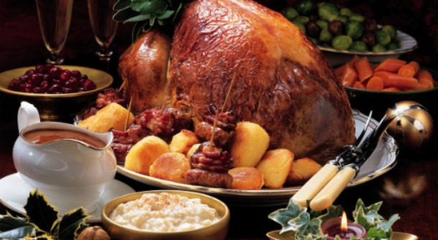
What Food do we eat at christmas
We eat Turkey, Potatoes, Christmas Pudding, carrots etc

Slide 3

Some Christmas Music.

Slide 4
Lyrics for song (Let it snow)
The fire is slowly dying, And my dear, we're still good-by-ing. But, as long as you love me so, Let It Snow! Let It Snow! Let It Snow!
Oh, it doesn't show signs of stopping, And I've brought some corn for popping, Since the lights are turned way down low, Let It Snow! Let It Snow! Let It Snow!
When we finally say goodnight, How I'll hate going out in the storm! But, if you'll really hold me tight, All the way home I'll be warm!

Slide 5
Why Do we have Christmas
We Have Christmas to celebrate Jesus birthday

